Slide 1
CHAPTER 5: INTRODUCTION TO SQL
Modern Database Management

Slide 2
Objectives
Define terms
Interpret history and role of SQL
Define a database using SQL data definition language
Write single table queries using SQL
Establish referential integrity using SQL
Discuss SQL:1999 and SQL:200n standards

Slide 3
SQL Overview
Structured Query Language
The standard for relational database management systems (RDBMS)
RDBMS: A database management system that manages data as a collection of tables in which all relationships are represented by common values in related tables

Slide 4
History of SQL
1970–E. Codd develops relational database concept
1974-1979–System R with Sequel (later SQL) created at IBM Research Lab
1979–Oracle markets first relational DB with SQL
1986–ANSI SQL standard released
1989, 1992, 1999, 2003–Major ANSI standard updates
Current–SQL is supported by most major database vendors

Slide 5
Purposes of SQL Standard
Specify syntax/semantics for data definition and manipulation
Define data structures and basic operations
Enable portability of database definition and application modules
Specify minimal (level 1) and complete (level 2) standards
Allow for later growth/enhancement to standard

Slide 6
Benefits of a Standardized Relational Language
Reduced training costs
Productivity
Application portability
Application longevity
Reduced dependence on a single vendor
Cross-system communication

Slide 7
SQL Environment
Catalog
A set of schemas that constitute the description of a database
Schema
The structure that contains descriptions of objects created by a user (base tables, views, constraints)
Data Definition Language (DDL)
Commands that define a database, including creating, altering, and dropping tables and establishing constraints
Data Manipulation Language (DML)
Commands that maintain and query a database
Data Control Language (DCL)
Commands that control a database, including administering privileges and committing data

Slide 8
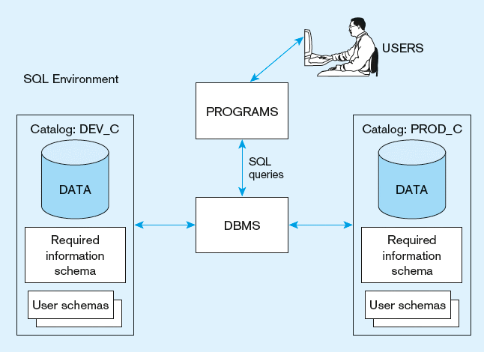
Figure 5-1: A simplified schematic of a typical SQL environment, as described by the SQL: 200n standard

Slide 9
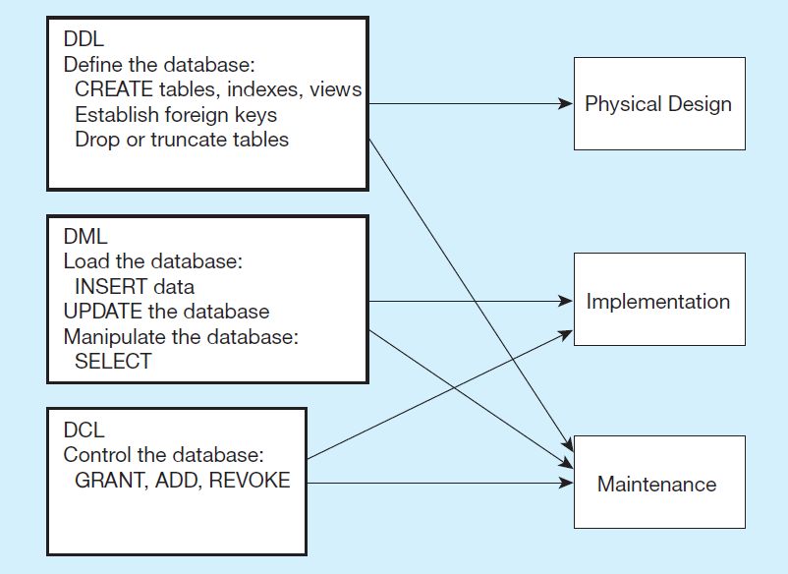
Figure 5-4: DDL, DML, DCL, and the database development process

Slide 10
SQL Data Types
Strings
CHARACTER (n), VARYING CHARACTER (n)
TEXT
Binary
Binary Large Object (BLOB)
Number
Numeric (precision, scale), Decimal (p, s), Integer
Temporal
Timestamp, Timestamp with local time zone
Boolean
True or False values

Slide 11
SQL Database Definition
Data Definition Language (DDL)
Major CREATE statements:
CREATE SCHEMA – defines a portion of the database owned by a particular user
CREATE TABLE – defines a new table and its columns
CREATE VIEW – defines a logical table from one or more tables or views
Other CREATE statements: CHARACTER SET, COLLATION, TRANSLATION, ASSERTION, DOMAIN

Slide 12
Steps in Table Creation
Identify data types for attributes
Identify columns that can and cannot be null
Identify columns that must be unique (candidate keys)
Identify primary key–foreign key mates
Determine default values
Identify constraints on columns (domain specifications)
Create the table and associated indexes

Slide 13
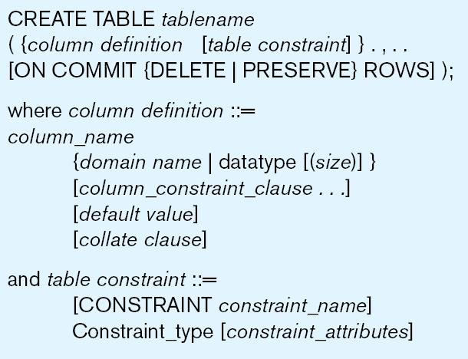
General syntax for CREATE TABLE statement

Slide 14
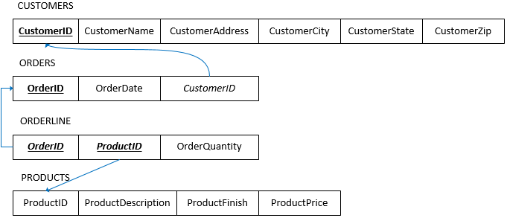
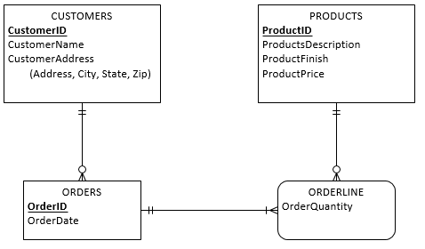
Example: CREATE TABLE
Conceptual Data Model
Relational Data Model

Slide 15
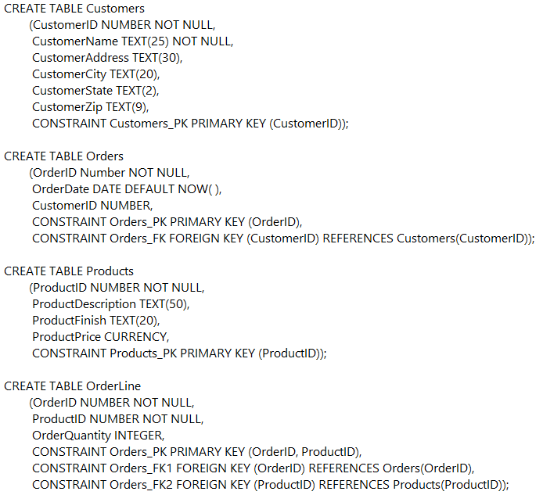
SQL database definition commands
Please pay attention to the order of creating tables
Create Customers Table
Create Orders Table
Create Products Table
Create OrderLine Table

Slide 16
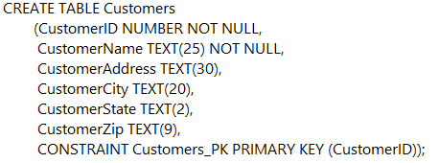
Defining attributes and their data type

Slide 17
Primary key and “not null” specification
Primary keys can never have NULL values
Identifying primary key

Slide 18
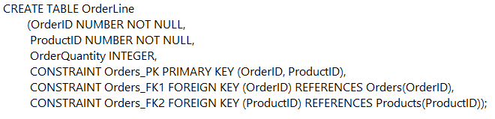
Composite primary key
Primary key
Some primary keys are composite.

Slide 19
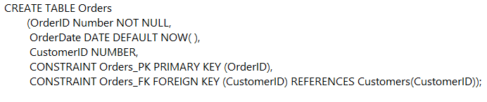
Domain constraint specifications
Default value

Slide 20
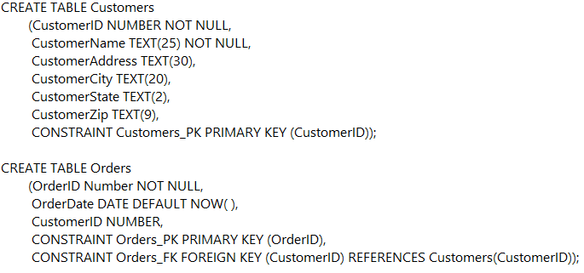
Identifying foreign keys and establishing relationships
Primary key of parent table
Foreign key of dependent table

Slide 21
Data Integrity Controls
Referential integrity–constraint that ensures that foreign key values of a table must match primary key values of a related table in 1:M relationships
Restricting:
Deletes of primary records
Updates of primary records
Inserts of dependent records

Slide 22
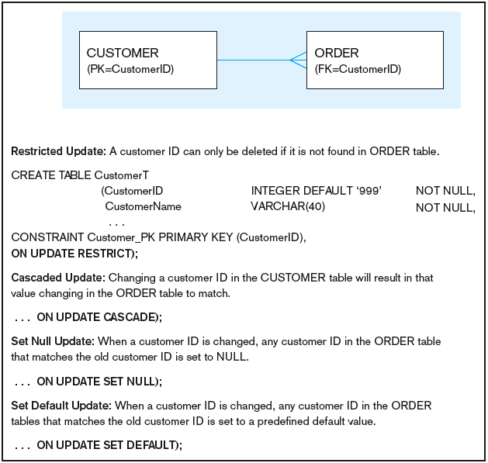
Figure 5-7: Ensuring data integrity through updates
Relational integrity is enforced via the primary-key to foreign-key match

Slide 23

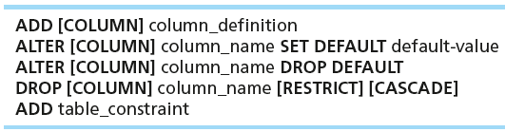
Changing Tables
ALTER TABLE statement allows you to change column specifications:
Table Actions:
Example (adding a new column with a default value):
ALTER TABLE Customers
ADD COLUMN CustomerType TEXT(20) DEFAULT ‘Commercial’,

Slide 24
Removing Tables
DROP TABLE statement allows you to remove tables from your schema:
DROP TABLE PRODUCTS

Slide 25
Insert Statement
Adds one or more rows (records) to a table
Inserting into a table
INSERT INTO Customers VALUES
(001, ‘Contemporary Casuals’, ‘1355 S. Himes Blvd.’, ‘Gainesville’, ‘FL’, ‘32601’);
Inserting a record that has some null attributes requires identifying the fields that actually get data
INSERT INTO Products (ProductID, ProductDescription, ProductFinish)
VALUES (1, ‘End Table’, ‘Cherry’);
Inserting from another table
INSERT INTO CaCustomers
SELECT * FROM Customers
WHERE CustomerState = ‘CA’;
Notes:
What does missing operator mean in SQL?
Usually it is a misspelled table or field name, two spaces instead of just one, a space instead of "_", any missing letter or something like that. Create a new query in MS Access and put the whole query in, then run it.

Slide 26
Creating Tables with Identity Columns
CREATE TABLE Customers
(CustomerID INTEGER GENERATED ALWAYS AS IDENTITY
(START WITH 1
INCREMENT BY 1
MINVALUE 1
MAXVALUE 10000
NOCYCLE),
CustomerName TEXT(25) NOT NULL,
CustomerAddress TEXT(30),
CustomerCity TEXT(20),
CustomerState TEXT(2),
CustomerPostalCode TEXT(9),
CONSTRAINT Customer_PK PRIMARY KEY (CustomerID));
Introduced with SQL:200n
Inserting into a table does not require explicit customer ID entry or field list
INSERT INTO Customers VALUES
( ‘Contemporary Casuals’, ‘1355 S. Himes Blvd.’, ‘Gainesville’, ‘FL’, 32601);

Slide 27
Delete Statement
Removes rows from a table
Delete certain rows
DELETE FROM Customers WHERE CustomerState= ‘HI’;
Delete all rows
DELETE FROM Customers;

Slide 28
Update Statement
Modifies data in existing rows
UPDATE Products
SET ProductPrice = 775
WHERE ProductID = 7;

Slide 29
Schema Definition
Control processing/storage efficiency:
Choice of indexes
File organizations for base tables
File organizations for indexes
Data clustering
Statistics maintenance
Creating indexes
Speed up random/sequential access to base table data
Example
CREATE INDEX NAME_IDX ON CUSTOMER_T(CUSTOMERNAME)
This makes an index for the CUSTOMERNAME field of the CUSTOMER_T table

Slide 30
SELECT Statement – Processing Single Table
Used for queries on single or multiple tables
Clauses of the SELECT statement:
SELECT
List the columns (and expressions) that should be returned from the query
FROM
Indicate the table(s) or view(s) from which data will be obtained
WHERE
Indicate the conditions under which a row will be included in the result
GROUP BY
Indicate categorization of results
HAVING
Indicate the conditions under which a category (group) will be included
ORDER BY
Sorts the result according to specified criteria

Slide 31
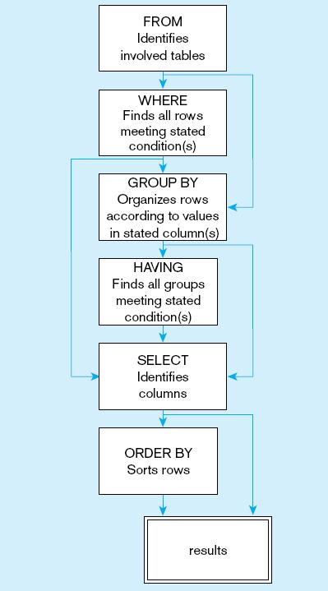
Figure 5-9: SQL statement processing order

Slide 32
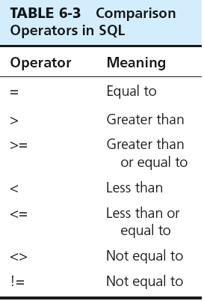
SELECT Example
Find products with standard price less than $275
SELECT ProductDescription, ProductPrice
FROM Products
WHERE ProductPrice < 275;
Table 5-3: Comparison Operators in SQL

Slide 33
Other Useful Non-Comparison Operators
LIKE
Typically used when a wildcard is used to indicate a text value
WHERE LastName=“Huang”
WHERE LastName LIKE “H%”
IN
Typically used to replace OR when multiple text values are involved
WHERE STATE=“GA” OR STATE=“FL” OR STATE=“TX”
WHERE STATE IN (“GA”, “FL”, “TX”)

Slide 34
SELECT Example – Using Alias
Alias is an alternative column or table name
Example – What is the address of the customer named “Home Furnishings? Use an alias, Name, for the customer name.
Query:
SELECT Cust.CustomerName AS Name, CUST.CustomerAddress
FROM Customers AS Cust
WHERE NAME = ‘Home Furnishings’;

Slide 35
SELECT Example – Using a Function
Using the aggregate function
Example – How many different items were ordered on OrderID 1004?
Example – How much is the average product price?
Query:
SELECT COUNT(*)
FROM OrderLine
WHERE OrderID = 1004;
SELECT AVG(ProductPrice) AS AveragePrice
FROM Products;
Note: with aggregate functions you can’t have single-valued columns included in the SELECT clause, unless they are included in the GROUP BY clause

Slide 36
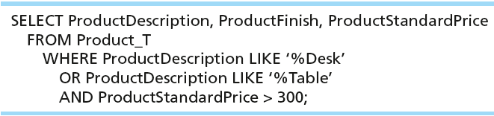
SELECT Example – Boolean Operators
AND, OR, and NOT Operators for customizing conditions in WHERE clause
Note: the LIKE operator allows you to compare strings using wildcards. For example, the % wildcard in ‘%Desk’ indicates that all strings that have any number of characters preceding the word “Desk” will be allowed.

Slide 37
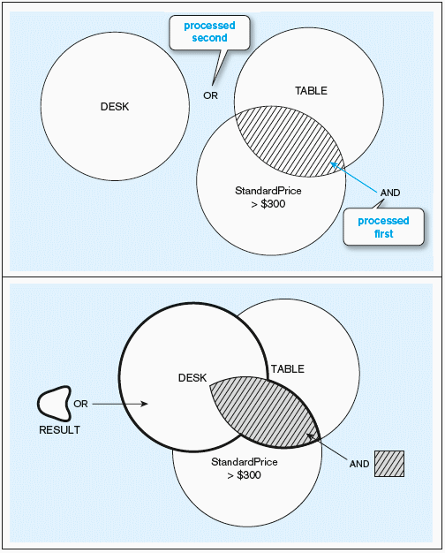
Figure 5-7: Boolean query without use of parentheses
By default, processing order of Boolean operators is NOT, then AND, then OR

Slide 38
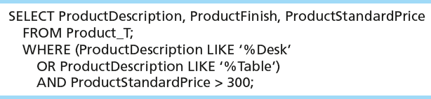
SELECT Example – Boolean Operators
With parentheses…these override the normal precedence of Boolean operators
Note: by default, the AND operator takes precedence over the OR operator. With parentheses, you can make the OR take place before the AND.

Slide 39
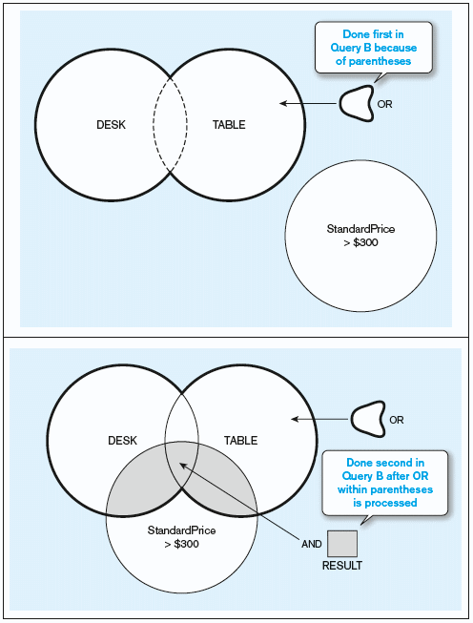
Figure 5-8: Boolean query with use of parentheses

Slide 40
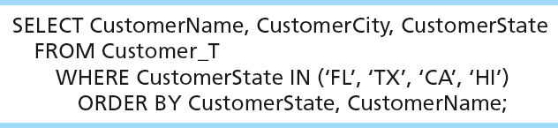
SELECT Example – Sorting Results with the ORDER BY Clause
Sort the results first by STATE, and within a state by the CUSTOMER NAME
Note: the IN operator in this example allows you to include rows whose CustomerState value is either FL, TX, CA, or HI. It is more efficient than separate OR conditions.

Slide 41

SELECT Example – Categorizing Results Using the GROUP BY Clause
Typically paired with aggregate functions
GROUP BY divides a table into subsets
The aggregate function then provides the summary information for that group, such as SUM, COUNT, AVERAGE, etc.
Note: you can use single-value fields with aggregate functions if they are included in the GROUP BY clause

Slide 42
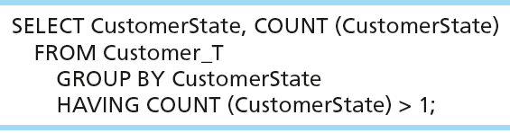
SELECT Example – Qualifying Results by Categories Using the HAVING Clause
For use with GROUP BY
Like a WHERE clause, but it operates on groups (categories), not on individual rows. Here, only those groups with total numbers greater than 1 will be included in final result.

Slide 43
Important Notes For Using Aggregate Function in SELECT
If you include other attributes in SELECT together with an aggregate function, you must use GROUP BY to categorize
HAVING command is only used when you need to indicate a condition about groups
‹#›

Slide 44
Using and Defining Views
Views provide users controlled access to tables
Base Table–table containing the raw data
Dynamic View
A “virtual table” created dynamically upon request by a user
No data actually stored; instead data from base table made available to user
Based on SQL SELECT statement on base tables or other views
Materialized View
Copy or replication of data
Data actually stored
Must be refreshed periodically to match the corresponding base tables

Slide 45
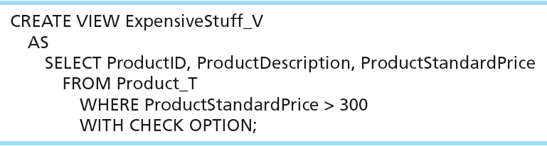
Sample CREATE VIEW
View has a name
View is based on a SELECT statement
CHECK_OPTION works only for updateable views and prevents updates that would create rows not included in the view

Slide 46
Advantages of Views
Simplify query commands
Assist with data security (but don't rely on views for security, there are more important security measures)
Enhance programming productivity
Contain most current base table data
Use little storage space
Provide customized view for user
Establish physical data independence

Slide 47
Disadvantages of Views
Use processing time each time view is referenced
May or may not be directly updateable

